Slide 1
MYANMAR
Flag of the State of Burma (1943–1945)
Flag of the Union of Burma (4 January 1948 – 3 January 1974)
COUNTRY AND IMAGES
Flag of the Socialist Republic of the Union of Burma (3 January 1974 – 18 September 1988), flag of the Union of Myanmar (18 September 1988 – 21 October 2010)
Flag of Republic of the Union of Myanmar 21 October 2010

Slide 2
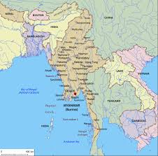
COUNTRY LOCATION
Myanmar (English pronunciation below; Burmese: [mjəmà]), officially the Republic of the Union of Myanmar and also known as Burma, is a sovereign state in Southeast Asia. Myanmar is bordered by India and Bangladesh to its west, Thailand and Laos to its east and China to its north and northeast. To its south, about one third of Myanmar's total perimeter of 5,876 km (3,651 mi) forms an uninterrupted coastline of 1,930 km (1,200 mi) along the Bay of Bengal and the Andaman Sea. The country's 2014 census counted the population to be 51 million people. As of 2017, the population is about 54 million. Myanmar is 676,578 square kilometres (261,228 square miles) in size. Its capital city is Naypyidaw, and its largest city and former capital is Yangon (Rangoon).

Slide 3
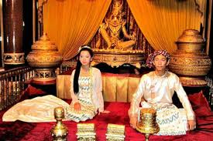
PEOPLE OF MYANMAR
OLD STYLE BURMESE
In the pre-colonial era, sumptuary laws called yazagaing dictated life and consumption for Burmese subjects in the Konbaung kingdom, everything from the style of one's house to clothing suitable to one’s social standing from regulations concerning funerary ceremonies and the coffin to be used to usage of various speech forms based on rank and social status. Designs with the peacockinsignia were strictly reserved for the royal family and long-tailed hip-length htaingmathein jackets and surcoats were reserved for officials.

Slide 4
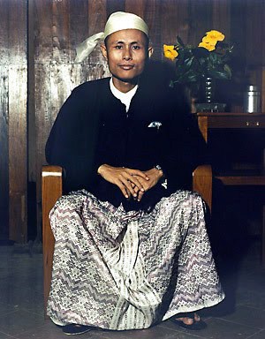
AUNG SAN AND BURMESE DRESS
Gaungbaung
The Burmese national costume for men includes a turban called gaung baung( [ɡáʊɴbáʊɴ]), which is worn for formal functions. During the colonial era, the gaung baung was streamlined as an article of Burmese attire. The design of the modern Burmese gaung baung emerged in the mid-1900s and is called maung kyetthayay.

Slide 5
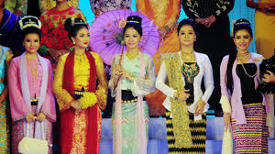
PEOPLE OF MYANMAR
TRADITIONAL STYLE OF GIRLS
Htaingmathein jacket
The most formal rendition of Myanmar's national costume for females includes a buttonless tight-fitting hip-length jacket called htaingmathein ([tʰàɪɴməθéɪɴ]), sometimes with flared bottoms and embroidered sequins. Htaingmathein in Burmese literally means "does not gather while sitting," referring to the fact that the tight-fitting jacket does not crumple up when sitting. This jacket was popular among the aristocratic classes during the Konbaung dynasty, and is now most commonly worn by females as wedding attire, or as traditional dance costume.

Slide 6
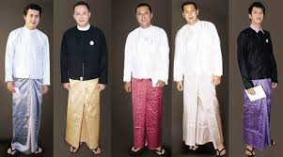
PEOPLE OF MYANMAR
TRADITIONAL STYLE OF BOYS
Longyi
The national costume of Myanmar is the longyi (Burmese pronunciation: [lòʊɴd͡ʑì]), an ankle-length wraparound skirt worn by both males and females. The longyi in its modern form was popularized during the British colonial period, replacing the traditional paso worn by men and htamein worn by women in pre-colonial times.
Taikpon jacket
For business and formal occasions, Bamar men wear a Manchu Chinese jacket called a taikpon eingyi [taɪʔpòʊɴ]) over an English collar shirt. This costume was popularized during the colonial era.

Slide 7
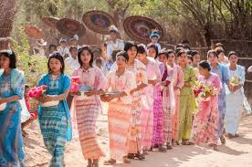
PEOPLE OF MYANMAR
TRADITIONAL FESTIVAL
Shinbyu (Burmese: hrang pru.; pronounced [ʃɪ̀ɴbjṵ], also spelt shinpyu) is the Burmese term for a novitiation ceremony (pabbajja) in the tradition of Theravada Buddhism, referring to the celebrations marking the sāmaṇera(novitiate) monastic ordination of a boy under the age of 20.It is deemed the most important duty that parents owe to their son by letting him go forth and embrace the legacy of Gautama Buddha, join the sangha and become immersed in the teachings of the Buddha, the Dhamma, at least for a short while, perhaps longer if not for the rest of his life. A boy may become a novice on more than one occasion, but by the age of twenty there will be another great occasion, the upasampada ordination, in which the boy becomes a fully ordained bhikkhu( bazin).

Slide 8
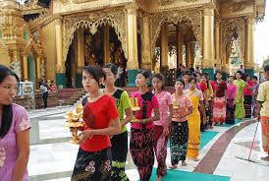
PEOPLE OF MYANMAR
TRADITIONAL FESTIVAL
Those who are not blessed with a male child will seek for an orphan boy or a boy from very poor families in order to receive this special dispensation by the Buddha and hence gain great merit by the act. Shinbyu may well be regarded as a rite of passage or coming of age ceremony as in other religions. Allowing a son to spend some time however short it may be, in a kyaung (Burmese Buddhist monastery) is regarded by most Burmese Buddhists as the best religious gift that his parents can give him and it is believed to have a lasting effect on his life.

Slide 9
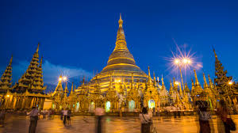
SHWE DAGON PAGODA
The Shwedagon Pagoda (Burmese: [ʃwèdəɡòʊɴ pʰəjá]), officially named Shwedagon Zedi Daw (Burmese: [ʃwèdəɡòʊɴ zèdìdɔ̀]) and also known as the Great Dagon Pagoda and the Golden Pagoda, is a gilded stupa located in Yangon, Myanmar. The 326-foot-tall (99 m) pagoda is situated on Singuttara Hill, to the west of Kandawgyi Lake, and dominates the Yangon skyline.

Slide 10
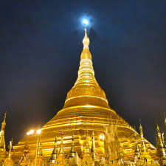
SHWE DAGON PAGODA
Shwedagon Pagoda is the most sacred Buddhist pagoda in Myanmar, as it is believed to contain relics of the four previous Buddhas of the present kalpa. These relics include the staff of Kakusandha, the water filter of Koṇāgamana, a piece of the robe of Kassapa, and eight strands of hair from the head of Gautama.

Slide 11
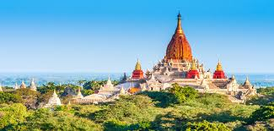
PAGAN ANCIENT CITY
Pagan gradually grew to absorb its surrounding states until the 1050s–1060s when A-Naw-Rahta founded the Pagan Kingdom, the first ever unification of the Irrawaddy valley and its periphery. In the 12th and 13th centuries, the Pagan Empire and the Khmer Empire were two main powers in mainland Southeast Asia. The Burmese language and culture gradually became dominant in the upper Irrawaddy valley, eclipsing the Pyu, Mon and Pali norms by the late 12th century.

Slide 12
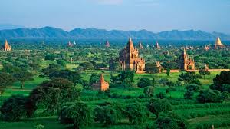
BAGAN ANCIENT CITY
From 1044 to 1287, Bagan was the capital as well as the political, economic and cultural nerve center of the Pagan Empire. Over the course of 250 years, Bagan's rulers and their wealthy subjects constructed over 10,000 religious monuments (approximately 1000 stupas, 10,000 small temples and 3000 monasteries) in an area of 104 square kilometres (40 sq mi) in the Bagan plains.

Slide 13
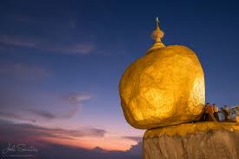
KYAITIYO PAGODA
Kyaiktiyo Pagoda (Burmese: [tɕaiʔtʰíjó pʰəjá]; Mon:[tɕaiʔ sɔeʔ jɜ̀]; also known as Golden Rock) is a well-known Buddhist pilgrimage site in Mon State, Burma. It is a small pagoda (7.3 metres (24 ft)) built on the top of a granite boulder covered with gold leaves pasted on by its male devotees. According to legend, the Golden Rock itself is precariously perched on a strand of the Buddha's hair. The balancing rock seems to defy gravity, as it perpetually appears to be on the verge of rolling down the hill. The rock and the pagoda are at the top of Mt. Kyaiktiyo. It is the third most important Buddhist pilgrimage site in Burma after the Shwedagon Pagoda and the Mahamuni Pagoda.

Slide 14
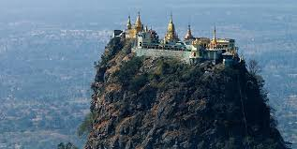
MOUNT POPA AND TAUNG KALAT (pedestal hill)
Many legends are associated with this mountain including its dubious creation from a great earthquake and the mountain erupted out of the ground in 442 BC.It is possible that the legends about Nats represent a heritage of earlier animist religions in Burmese countryside, which were syncreticised with Buddhist religion in the 11th century. There are legends that before the reign of Bagan king Anawrahta (1044 - 1077) hundreds of animals were sacrificed here as a part of nat worship rituals. Mount Popa is considered the abode of Burma's most powerful Nats and as such is the most important nat worship center. It has therefore been called Burma's Mount Olympus.

Slide 15
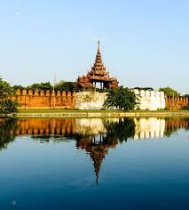
MANDALAY
Mandalay is a city and former royal capital in northern Myanmar (formerly Burma) on the Irrawaddy River. In its center is the restored Mandalay Palace from the Konbaung Dynasty, surrounded by a moat.
Mandalay is Burma's cultural and religious center of Buddhism, having numerous monasteries and more than 700 pagodas. At the foot of Mandalay Hill sits the world's official "Buddhist Bible", also known as the world's largest book, in Kuthodaw Pagoda. The styles of Mandalay Buddha Images and Buddha Statues were many since King Mandon, who was a devout Buddhist, and had filled Mandalay with them and through the years Mandalay Buddhist art became established as the pure art of Myanmar. There are 729 slabs of stone that together are inscribed with the entire Pāli canon, each housed in its own white stupa.

Slide 16
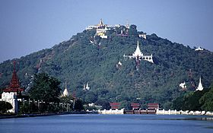
MANDALAY HILL
Mandalay Hill
(Burmese: manta. le: taung[màɴdəlé tàʊɴ]) is a 240 metres (790 ft) hill that is located to the northeast of the city centre of Mandalay in Myanmar. The city took its name from the hill. Mandalay Hill is known for its abundance of pagodas and monasteries, and has been a major pilgrimage site for Burmese Buddhists for nearly two centuries.

Slide 17
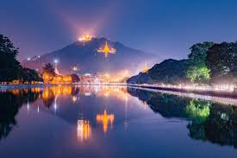
MANDALAY HILL
At the top of the hill is the Sutaungpyei (literally wish-fulfilling) Pagoda. A panoramic view of Mandalay from the top of Mandalay Hill alone makes it worthwhile to attempt a climb up its stairways. There are four covered stairways called saungdan leading up the hill from the south, southeast, west and north, and convenient seats of masonry work line these stairways all the way up. A one-way motor road today saves time and also makes it accessible for those who are unable to climb up the stairs, leading to an escalator and a lift to the pagoda at the summit.

Slide 18
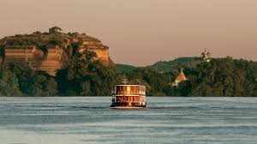
IRRAWADDY RIVER
The Irrawaddy or, officially, Ayeyarwady River (Burmese:erawa.timrac, pronounced [ʔèjàwədì mjɪʔ], alsospelt Ayeyarwaddy ) is a river that flows from north to south through Myanmar. It is the country's largest river and most important commercial waterway. Originating from the confluence of the N'mai and Mali rivers, it flows relatively straight North-South before emptying through the Irrawaddy Delta into the Andaman Sea. Its drainage basin of about 404,200 square kilometres (156,100 sq mi) covers a large part of Burma. After Rudyard Kipling's poem, it is sometimes referred to as 'The Road to Mandalay’.

Slide 19
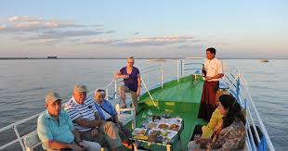
TOURING IRRAWADDY
Sail the majestic Irrawaddy River from Bagan to Mandalay, visiting temples, pagodas, palaces and monasteries along the way. On this five-star luxury cruise you'll experience the best that Myanmar has to offer. A Burma river cruise experience is far removed from that which is the norm on European rivers like the Rhine River or Danube River. Vessels range from ultra-luxury to traditional Burmese style, but what they have in common is the incomparable scenery. The ships there are smaller and have a much shallower draft due to the very nature of the Irrawaddy and Chindwin Rivers, where sandbanks are a permanent hazard to shipping.

Slide 20
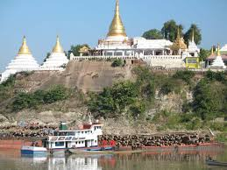
IRRAWADDY VIEWS
As early as the sixth century, the river was used for trade and transport. Having developed an extensive network of irrigation canals, the river became important to the British Empire after it had colonized Burma. The river is still as vital today, as a considerable amount of (export) goods and traffic moves by river. Rice is produced in the Irrawaddy Delta, irrigated by water from the river.
Today, the Irrawaddy is still the country's most important commercial waterway. Despite Mandalay's position as the chief rail and highway focus in northern Burma, a considerable amount of passenger and goods traffic moves by river.

Slide 21
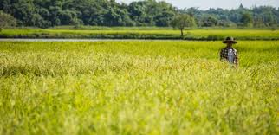
GREEN LAND OF BURMA
Agriculture in Myanmar (also known as Burma)
is the main industry in the country, accounting for 60 percent of the GDP and employing some 65 percent of the labour force. Burma was once Asia's largest exporter of rice, and rice remains the country's most crucial agricultural commodity.
Other main crops include pulses, beans, sesame, groundnuts, sugarcane, lumber, and fish. Moreover, livestock are raised as both a source of food and labour.

Slide 22
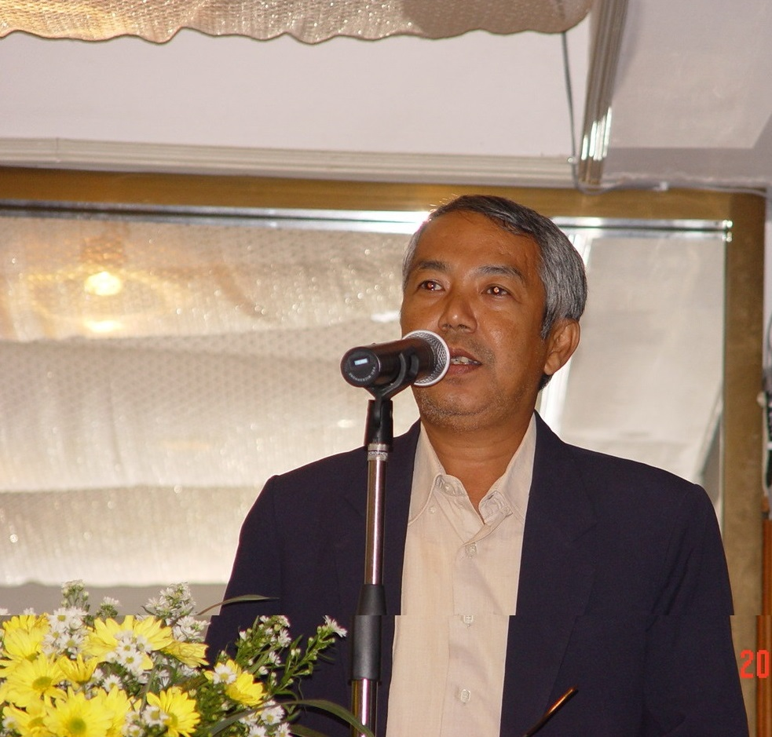
THANKS TO EVERYONE
Myint Htu

