Slide 1
Notes:
Good morning, and thank you for coming. It means an incredible amount to our organization and to me personally that you would set aside time on your Thursday lunch to learn about asylum policy of all things.
I want to suggest, in the presentation I am about to give to you all, that this is not a problem “over there” or for others. You might imagine, as it is our organization hosting this event, that we believe this issue is painfully relevant to us right now, right here, in Greeley.
I don’t mean for this to sound hyperbolic in the slightest, but I truly believe this issue evokes our most basic principles as Americans, our most basic creedal beliefs.
We hold these truths to be self-evident that all men are created equal, endowed by their creator with certain inalienable rights that among these are life, liberty, and the pursuit of happiness.
We have inscribed on our currency and upon the walls of our many institutions the national motto of the United States, E Pluribus Unum, out of many, one.
Immigration and asylum are deeply American traditions in the best sense, and our hope for this event is that we can impress that upon us here.

Slide 2
Notes:
In May 1939, the German liner St. Louis sailed from Hamburg, Germany, to Havana, Cuba, carrying 937 passengers, almost all Jewish refugees. The Cuban government refused to allow the ship to land, and the United States and Canada were unwilling to admit the passengers. In the United States, isolationism during the Great Depression grew and made Americans weary of helping immigrants, especially those from central and southern Europe. There was incredible xenophobia and a fear of people from that region, mostly on account of their being catholic or Jewish. The ship was pushed out of Havana Cuba and sailed slowly toward Miami in the hopes of being allowed to dock. People aboard the ship sent telegrams to the White House and the State Department, but they never heard back from the former and the latter told them to get in line the right way like everyone else. We had quotas for people from Germany, and that quota was already filled up — it was an incredibly small quota, as the system in place during that time was based upon the 1910 census, when there were more Europeans who were protestant. FDR could have issued an executive order to bring the boat into port, but he was gearing up for an unprecedented third term in office, and isolationist Republicans already viewed him as too close to European interests — it wasn’t worth the political capital.
The boat was turned away. The people upon that boat were returned to Europe where hundreds of them died in the holocaust.
The United States had a decision to make in that instance, and we decided that election results, isolationism, nativism, and xenophobia were worth more than those people we had the capacity to help.

Slide 3
Notes:
After the war, with the scale of the devastation being so unparalleled in human history and with the sins of our neglect toward those people trying to flee still fresh in our minds, the international community, led by the United States, decided that a new international framework was needed. No longer would it be the case that we were unprepared to handle those people facing displacement — the task was too big for any one country, but it was something we could handle and do well if we had a framework in mind. To this end, we gathered for the creation of the United Nations in 1945, and then again in 1948 to draft the Universal Declaration of Human Rights. Internal to this document was, in Article 14, a basic human right which we still affirm today. The right was this: that everyone has the right to seek and to enjoy in other countries asylum from persecution. This is an agreed-to human right, and for good reason.
What was required next was a way of figuring out how we were going to define that persecution specifically.

Slide 4
Notes:
To that end, the international community gathered again in 1951 to define as a refugee as one who, owing to a well-founded fear of being persecuted for reasons of race, religion, nationality, membership in a particular social group or political opinion, is outside the country of his nationality and is unable to, or owing to such a fear, unwilling to, avail himself of the protection of that country.
In other words, there are three constituent elements to determining if someone had a reasonable claim: there is an immutable trait about some person for which he is receiving persecution, and that persecution is forcing him outside the borders of his own country because his own government is either incapable of protecting him or complicit in that persecution.
With that definition in place, we came up with durable solutions for how we would deal with refugees — and this will be quite familiar to those of you who have been following our workfor some time — either that refugee is repatriated back to their country when the situation is safe, they are allowed to locally integrate into a second country and make their life there, or they are resettled to a third country that chooses that person to start a new life there, and this is the option the United States uses since the Refugee Act of 1980.

Slide 5
Notes:
So we have a system in place for refugees. Though imperfect, it’s a system that has an infrastructure. The person is displaced, ends up in either a refugee camp or in an urban setting elsewhere where refugee processing and vetting can take place, that person waits for a solution to be determined for him, and then that solution is enacted. And the United States has, historically, been really good at making this system of resettlement work. At the end of the Obama administration, we were set to take in 110,000 refugees from around the world that year — we saw it as our duty to lead the international community and a moral obligation as the richest country to do the largest share. We remembered our history of turning people away.

Slide 6
Notes:
To understand our policy toward asylum seekers, it’s important to get some terms straight.
Under international law, immigrants differ from refugees and asylum seekers insofar as they are seen as groups who are leaving their country by choice — in order to have a better life. This fits with a privileged 19th century idea of immigrants being the type of pack up their bags, save up their money, and try for a new life in a new land. Yet this still informs our policy. By contrast, refugees and asylum seekers are the same in definition in that they are seen as people who have NO CHOICE in leaving their homes. Refugees, though, are put into an international system to have their problems solved: the United Nations High Commissioner on Refugees (UNHCR) processes refugees and grants that status. Conversely, asylum seekers are not asking the international community for protection, they are asking a specific country for protection. This is a small but hugely significant point (if you leave remembering one point, perhaps consider this one). As asylum seekers are seeking protection from a specific country, it is up to that country to say yes or no — it’s up to the domestic political decisions of that population, in a democracy. It’s up to us, in theory. The international community doesn’t get a say in this decision.

Slide 7
Notes:
The difference is subtle: is the person applying for help inside or outside of the country they are seeking asylum from? This difference means they are open to a whole different set of protections.
For refugees, there is a process. For asylum seekers — people who also do not have a choice in leaving their homes, just like refugees — there is no process. Instead, we have a history of criminalizing and stigmatizing these people. Let’s look at that further in depth

Slide 8
Notes:
The 1996 Laws
Prior to 1996, we did not have have mass detention centers for immigrants; we hardly had a system in place. People who needed asylum came to the United States, said it was unsafe to go home, were given a credible fear interview to see why they couldn’t go home, and then were released by immigration into the country to live and work until their asylum trial was handled.
This changed in the election year of 1996. Bill Clinton, deeply invested in the mid-90’s zeitgeist of criminal justice reform and welfare reform passed the Illegal Immigrant Reform and Immigrant Responsibility Act (IIRAIRA). The law created a zone of 100 miles around the border where Customs and Border Patrol could apprehend individuals found to be crossing between ports of entry and place that person into an expedited deportation process. The thinking was, the sooner you catch and deport someone, the less incentive that person has to stay. This legislation also designated funding toward the construction and maintenance of immigrant detention centers, now to be run by the private prison companies which had been lobbying for this privilege for some time — groups including Geo Group that runs the detention center in Aurora. To take this one step further, the law also passed, in section 287-G, the ability for immigration enforcement to deputize local law enforcement to carry out federal prerogatives. In effect, we stripped the process down to street level bureaucrats, individuals who are not judges are who are not trained in country conditions, to be the ones to adjudicate the claims made by people fleeing their homes.
We moved the process of asylum out of the mindset of humanitarian assistance and processing into the realm of criminal justice — because it was politically expedient to do so.
1996 IRAIRA
Passed in August of Election Year
Illegal Immigration Reform and Immigrant Responsibility Act
Transformed how we process asylum seekers
For the first time, we created expedited removal
Gives officer at border authority to judge if someone has a credible fear
These people are not experts in country conditions or in what the circuits/ Supreme Court

Slide 9
Notes:
Real ID
Building upon this in 2005, and with skepticism about border crossings rising in the mid-2000s, the Bush administration passed Real ID. This legislation also targeted those seeking asylum and further changed the rules of the game against them. Now, claims being made by these asylees had to demonstrate a “clear nexus” between their situation and one of those five protected classes from the refugee definition and the refugee act of 1980. If there is not a clear nexus between them, no asylum. Further, that person who is fleeing had to bring supporting evidence for his or her claim. You say you have received threats, prove it. Further, the asylum officers themselves would be the initial judges of a client’s claims: were they internally consistent, were they seen as “plausible” by that person who didn’t know the country conditions?
George W Bush: Real ID Act
Any inconsistencies mean an asylum denial

Slide 10
Notes:
Obama-era family detention
This got worse under the Obama administration — this is recent history. Under the same administration that raised our refugee quota to 110,000. Under the guise of “secure communities” legislation, deportation of immigrants was massively expanded giving the administration the largest share of deportations of any administration prior. Further, detention near the border was increased, and detention centers were built in remote locations away from lawyers and away from public scrutiny.
The mindset informing how we dealt with anyone entering our country between ports of entry was not “is this person seeking refuge” but “this person is a criminal.” They should wait in line like everyone else.
Use of detention married with expedited removal started under Obama
Built detention centers away from cities and away from lawyers
While people are in detention, many people did not have access to lawyers or know how to contact them

Slide 11
Notes:
Zero Tolerance
This situation finally caught the public’s attention during the Trump administration, only recently despite having been getting worse for the last 20 years.
Under Zero Tolerance, children were forcibly removed from parents as a deterrent to keep people from trying to get in.
In order to get those children back, these asylum seekers (without lawyers) were told that they would have to sign away their right to ask for asylum and they would be put into expedited deportation proceedings. The bargain was this: admit you entered our country illegally (a misdemeanor) and forfeit your right for asylum, and then we will deport you with your children.
On top of this, thanks to a directive signed by Jeff Sessions in April of last year, gang violence and domestic violence would no longer be seen as valid reasons to seek asylum because they are not directly linked to one of those five protected classes: race, religion, nationality, membership in a particular social group, or political opinion.

Slide 12
Notes:
Remain in Mexico Plan
As the icing on the cake, the Trump administration also agreed with the incoming Obredor administration, to keep migrants from the Caravan in Mexico while they awaited asylum hearings.
I’ll remind the audience that we agreed in 1948 to the statement that people have a right to seek asylum.
This was sold to the public, during a fraught midterm, that this would protect people in Mexico.
The problem, of course, is that these individuals fleeing violence from the Northern Triangle are still in the reach of the cartels and gangs in Mexico. Tijuana last year had over 2,000 murders. This is not a place that is safe for people fleeing violence and fleeing for their lives.

Slide 13
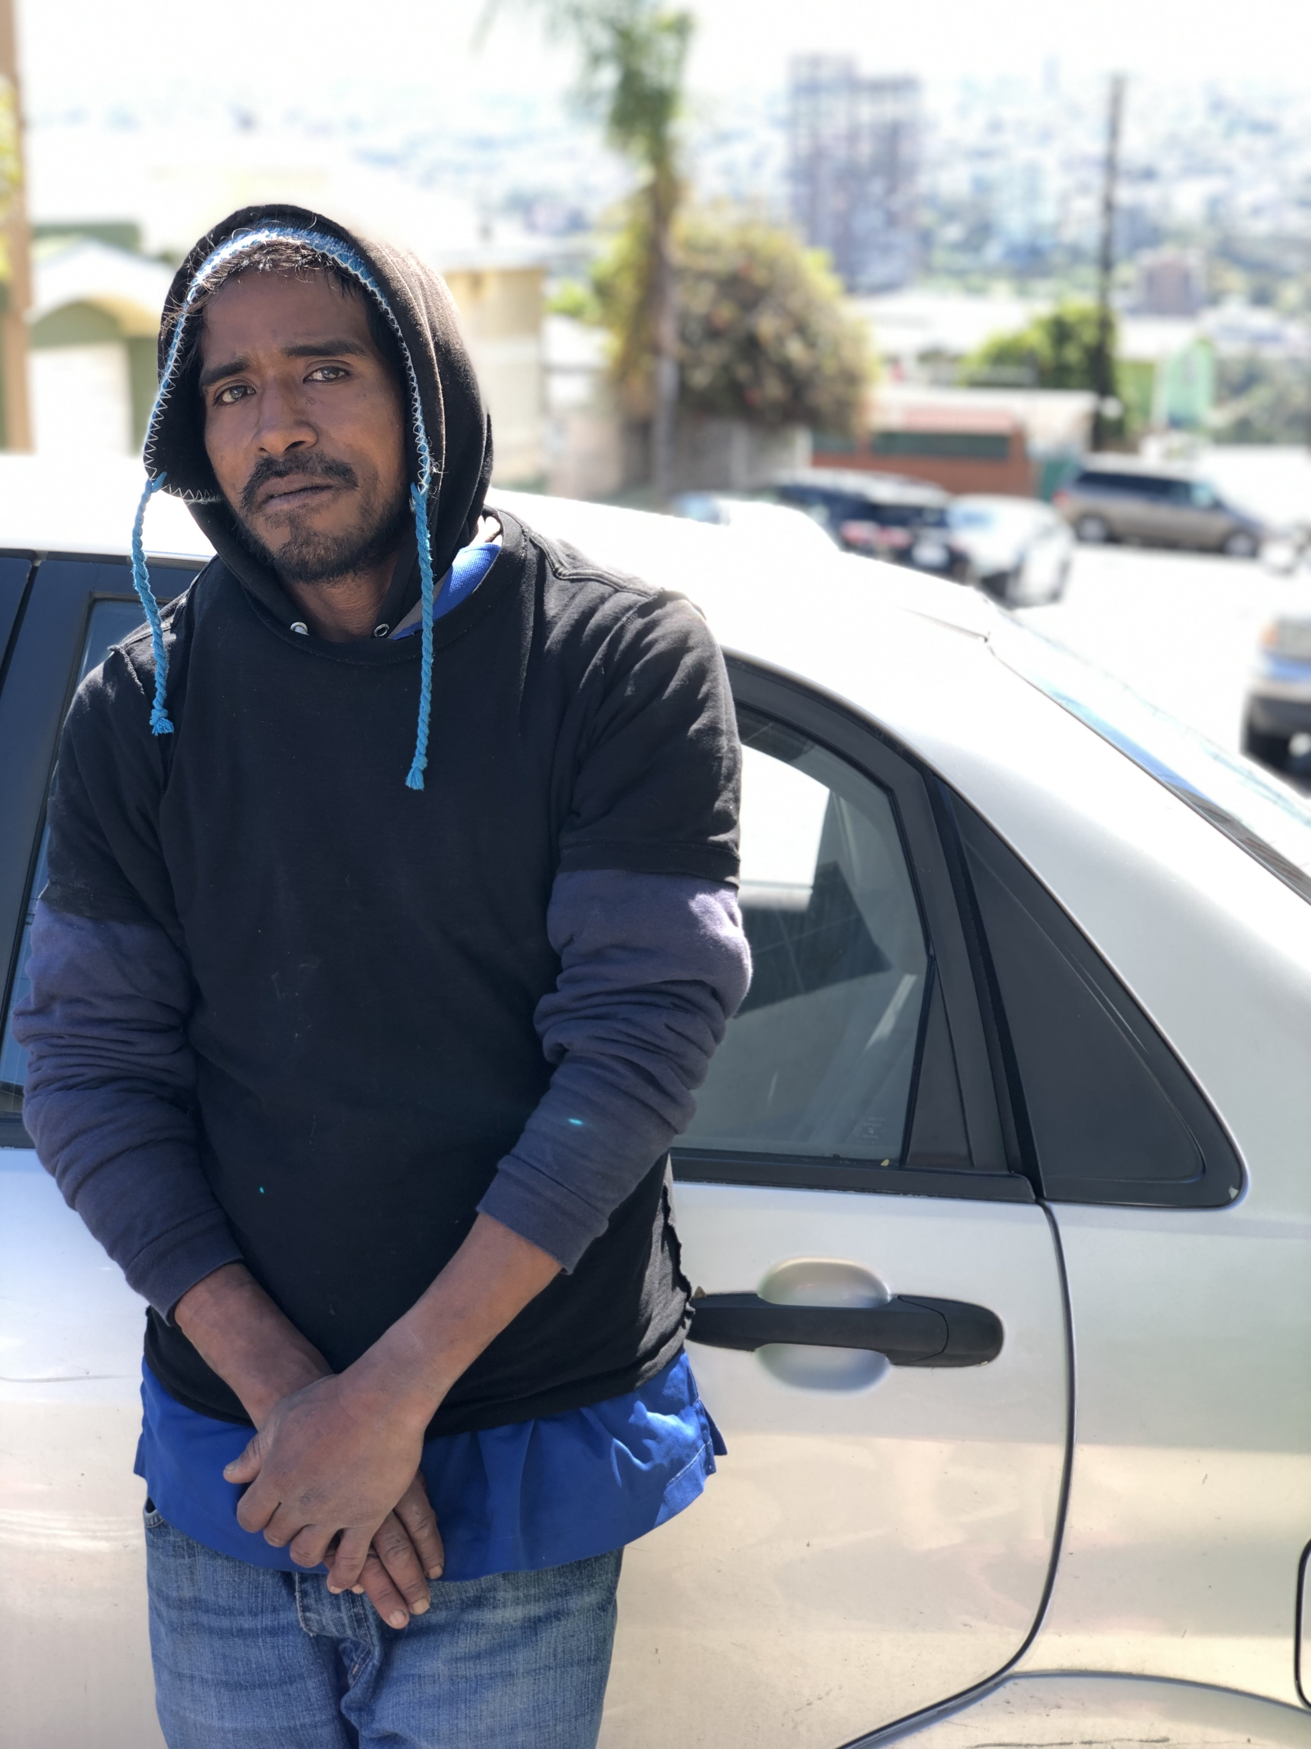

Slide 14
Notes:
Hannah Arendt Quote:
Eichmann, much less intelligent and without any education to speak of, at least dimly realized that it was not an order but a law which had turned them all into criminals. The distinction between an order and the Führer's word was that the latter's validity was not limited in time and space, which is the outstanding characteristic of the former. This is also the true reason why the Führer's order for the Final Solution was followed by a huge shower of regulations and directives, all drafted by expert lawyers and legal advisors, not by mere administrators; this order, in contrast to ordinary orders, was treated as a law. Needless to add, the resulting legal paraphernalia, far from being a mere symptom of German pedantry and thoroughness, served most effectively to give the whole business its outward appearance of legality.
And just as the law in civilized countries assumes that the voice of conscience tells everybody, "Thou shalt not kill," even though man's natural desires and inclinations may at times be murderous, so the law of Hitler's land demanded that the voice of conscience tell everybody: "Thou shalt kill," although the organizers of the massacres knew full well that murder is against the normal desires and inclinations of most people. Evil in the Third Reich had lost the quality by which most people recognize it — the quality of temptation.
The trouble with Eichmann was precisely that so many were like him, and that the many were neither perverted nor sadistic, that they were, and still are, terribly and terrifyingly normal. From the viewpoint of our legal institutions and of our moral standards of judgment, this normality was much more terrifying than all the atrocities put together, for it implied — as had been said at Nuremberg over and over again by the defendants and their counsels — that this new type of criminal, who is in actual fact hostis generis humani, commits his crimes under circumstances that make it well-nigh impossible for him to know or to feel that he is doing wrong.

Slide 21
Notes:
Zisse 1

Slide 22
Notes:
Zisse 2

Slide 23
Notes:
Zisse 3

